Slide 1


Aturan
Perkuliahan
Pengolahan Sinyal Digital

Slide 2
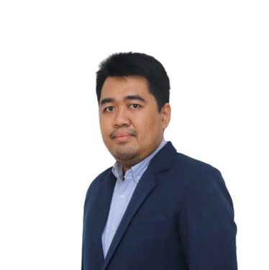

Bachelor at Telkom University in
Physics Engineering (Instrumentasi dan Kontrol)
Master at Bandung of Institute Technology in Physics Engineering (Otomasi Proses Industri)
riza.saputra@lecturer.itk.ac.id
Hello!
0852-476-82-476
I’m Riza Hadi Saputra, S.T., M.T
Gedung B Ruang B101 (Prodi TE)

Slide 3
Rencana Jadwal Perkuliahan (UTS)
Signal Digital Processing
1
DFT 1
Sampling
2
Quiz 2
3
4
DFT 2
5
FFT 2
6
7
UTS
FFT 1
Coding
Python
FFT
8

Slide 4
Rencana Jadwal Perkuliahan (UAS)
Signal Digital Processing
Coding
Python
FIR
16
Kuis 2
14
15
13
UAS
FIR Struktur
Coding
Python
IIR
11
12
10
IIR Struktur
FIR Desain
9
IIR Desain

Slide 5
Nilai Perkuliahan
Signal Digital Processing
Komponen Penilaian | Presentase
Tugas | 30%
Quiz | 20%
UTS | 20%
UAS | 30%
TOTAL | 100%
Nilai Angka | Nilai Huruf
86 ≤ Nilai = 100 | A
76 ≤ Nilai < 86 | AB
66 ≤ Nilai < 76 | B
56 ≤ Nilai < 66 | BC
51 ≤ Nilai < 56 | C
41 ≤ Nilai < 51 | D
0 = Nilai < 41 | E

Slide 6
Simulasi Nilai
Signal Digital Processing
Tugas |  |  |  |  | Quiz |  | UTS | UAS | Total Nilai
I | II | III | IV | V | I | II
6 | 6 | 6 | 6 | 6 | 10 | 10 | 20 | 30 | 100
3 | 3 | 3 | 3 | 3 | 5 | 5 | 10 | 20 | 55

Slide 7
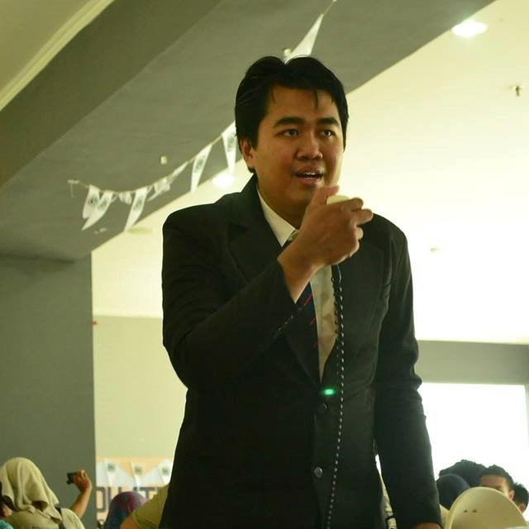
Nothing will get done, if you just complain about it
-Riza Hadi Saputra-

